Slide 1
CSE 212
Database Systems Lab

Slide 2


Presented by
md. Asadujjaman noor
Sheikh Nafez Sadnan

Slide 3

MATRIMONY DATABASE

Slide 4
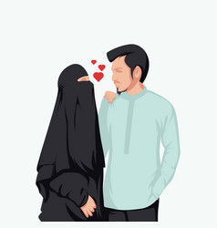
INTRODUCTION
Welcome to our matrimony database. Here we are going to cover up an example of a matrimonial site. This site will focus on finding the perfect matches!

Slide 5
e-r diagram
Candidate
Cnd_id
Cnd_name
Gender
_{personal_information}
Cnd_id
Cnd_name
Marital_status
Education
Occ.
Date of Birth
Address
Height
Blood_Group
Nationality
Religion
Phone_no
Family Status
Has
Cnd_id
Father_name
Father_occ
Mother_name
Mother_occ
No_of_Brothers
No_of_Sisters
Have

Slide 6
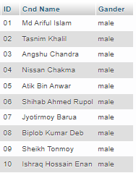
Show only Male Data
SELECT *
FROM candidate WHERE(gender='male');

Slide 7
Show Personal Information whose ID is 04
SQL:
SELECT *
FROM personal_information
WHERE(ID=04);

Slide 8
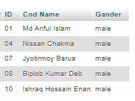
Show Unmarried Male using Subquery
SQL:
SELECT * FROM candidate
WHERE Gander='male' and ID in
( SELECT ID FROM personal_information
WHERE `Marital status`='Unmarried');

Slide 9
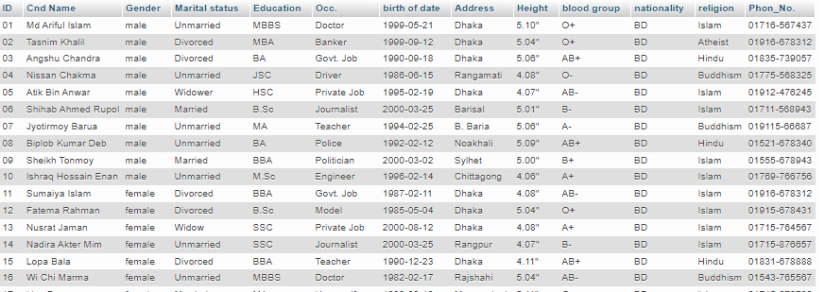
Using JOIN function
SELECT *
FROM candidate c JOIN personal_information p USING(ID);

Slide 10
Thank You All

